Slide 1
Lesson 3: The Heart Speaking Truth

Slide 2
“What is truth?”
John 18:38

Slide 3
Truth is…
Constantly attacked
“Gaslighting”
Gamed
Contorted
Deftly crafted
Compromised

Slide 4
Isaiah 59:14
“Justice is turned back, and righteousness stands far away; for truth has stumbled in the street, and uprightness cannot enter.”
One study found that most people tell as many as FIFTY lies a day!

Slide 5
Truth by the Divine…
Jesus Christ was truth in the flesh (John 7:46)
Jesus Christ lived truth (John 14:6)
God always communicated with truth
(Psalm 19:9)
IF God is always true and if His Son was truth incarnate, THEN those professing devotion must communicate with absolute truth!

Slide 6
Trust MIS-Communicated…
The Devil “covers up” lies by a pretended truth
Absolute Truth is under attack
Truth is being “covered up” by AI
a lawyer filed documents citing 45 cases, half did not exist
a lawyer submitted legal arguments based on five fictional precedents

Slide 7
“Potemkin villages”
Empress Catherine regarding the prosperity of Russia
Painted large boards to present a near-perfect illusion
“[But these] facades no longer speak the truth. They are not what is painted on them, they never were and never will be.”

Slide 8


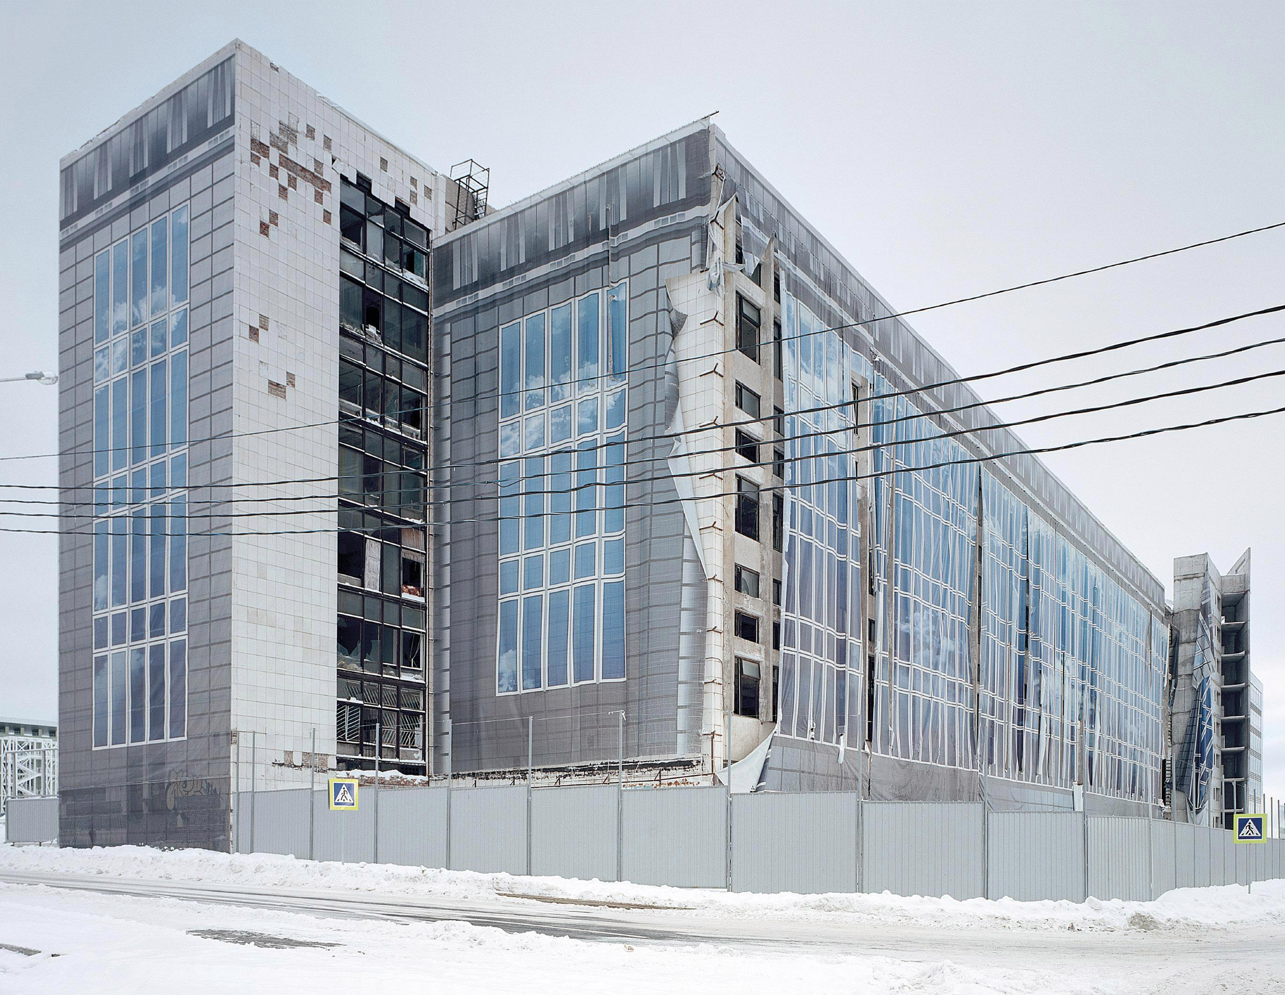
“Potemkin villages”

Slide 9
A Sad Tragedy…
Very little trust in people being truthful
The majority ask, “What is truth?”
Confidence for politicians, news media, and even churches
A tragic historical cycle

Slide 10
The crumbling civilization shuns truth:
“Truth is lacking (nowhere to be found), and one who turns aside from (shuns; repudiates; confronts) evil makes himself a prey (Isaiah 59:15).

Slide 11
This degenerate culture is now passed to our children and grandchildren.
Are they being taught to “honor their word” even if it is going to cost them financially?
Who are the “truth-tellers” with integrity in their speech and life?
How can absolute truth be communicated so we emulate God and Christ in telling the truth?

Slide 12
Verbal Truth…
Christ’s followers govern their communication (Matthew 5:33-37)
“This is true—I PROMISE!” “Pinkie promises,” “cross my heart and hope to die” or “I swear on …”
The Lord’s Disciples do not need external guarantees of integrity.
Do not play word games that in reality are truth games

Slide 13
A Compromised Truth is…
First, Satan’s native language—a deliberate lie (John 8:44)

Slide 14
Why do people lie?
Pride
Laziness
Defense
Fear
Proverbs 12:22, “Lying lips are an abomination to the Lord, but those who deal faithfully are His delight.”

Slide 15
A Compromised Truth is…
First, Satan’s native language—a deliberate lie (John 8:44)
Second, the “white” lie (Genesis 12:13)
Third, empty promises (2 Corinthians 1:17)
Such are not devious, just undependable—they are untruthful!

Slide 16
Matthew 12:36-37
The Greek term translated “careless” is from ἀργός and communicates a very blunt, harsh reality.
One whose words do “not work” will be held in divine contempt at the Judgment!

Slide 17
A Compromised Truth is…
First, Satan’s native language—a deliberate lie (John 8:44)
Second, the “white” lie (Genesis 12:13)
Third, empty promises (2 Corinthians 1:17)
Fourth, flattery (Psalm 12:3; Jeremiah 6:14; Proverbs 29:5)

Slide 18
Avoiding flattery
1 Thessalonians 2:4-5
Galatians 4:16

Slide 19
A Compromised Truth is…
First, Satan’s native language—a deliberate lie (John 8:44)
Second, the “white” lie (Genesis 12:13)
Third, empty promises (2 Corinthians 1:17)
Fourth, flattery (Psalm 12:3; Jeremiah 6:14; Proverbs 29:5)
Fifth, honesty in combat boots (Ephesians 4:15, 25)

Slide 20
The truth must be communicated with love that is accented with “kindness.”
Some must be dealt with in harsh terms because they refuse to follow God, repudiate biblical doctrine, and live as blasphemers!

Slide 21
Some Concluding Questions
What are your motives in speaking “truth”?
(Romans 12:10; Philippians 2:3)
Have you established the correctness of the “truth” you speak?
Has your mind twisted “truth”?
Are you presenting “truth” from genuine love?
Do you need to verbalize “truth” at this time?
(Proverbs 17:27)

Slide 22
“Speaking the truth in love, we will grow up into all things unto Him who is the Head, that is Christ” (Ephesians 4:15).

