Slide 1
When Inequities Are Balanced
11

Slide 2
Habakkuk’s Journey
Began with a protest to God
Accused God of inaction and apathy
The prophet’s short sightedness
Learned God is working

Slide 3
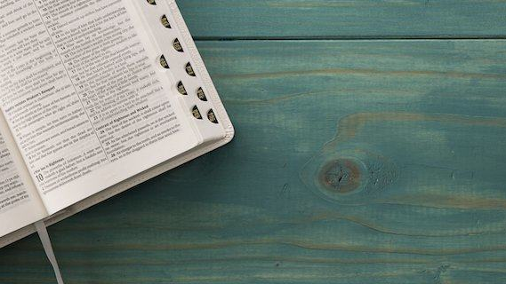
Our Present Text…
Reveals how the inequities will be balanced
Gives reason for conclusive convictions

Slide 4
A Fitting Conclusion
Habakkuk’s faith triumphs
Focus is on the Almighty God
Begins and ends with a prayer
Began by looking at man’s injustice and forgetting God
The Almighty’s ways are never hindered

Slide 5
The Passage Considered
Introduced as a prayer
Scans history
Truths of 3:1-16 have become the governing standard

Slide 6
Habakkuk’s Closing Thoughts
Had his questions answered by God
Knows that evil injustice will never escape God

Slide 7
3 Responses
The prophet’s response – COMPLETE CONFIDENCE!

Slide 8
A Prayer of Absolute trust
Humility
Adoration
When you confront life’s perplexities with a confident prayer-life, all problems begin to take proper perspective in relation to God’s great power!

Slide 9
The Prophet’s Response
A PRAYER of absolute trust (3:1)
A FEAR regarding God’s awesome wrath (3:16a)

Slide 10
Habakkuk realized that Judah’s punishment was inevitable
God had the right to do whatever He chose with Judah
Others shared this fear of God’s wrath (Daniel 10:8; Job 40:5)
Habakkuk was completely confident

Slide 11
The Prophet’s Response
A PRAYER of absolute trust (3:1)
A FEAR regarding God’s awesome wrath (3:16a)
A RESIGNATION to wait for God to act (3:16b)

Slide 12
Habakkuk confessed his willingness to wait and submit to God’s time-table
Such submission brings rewards (Psalm 27:14)
This was not concession to evil or defeat

Slide 13
3 Responses
The prophet’s response – COMPLETE CONFIDENCE!
The Lord’s response – COMPLETE COMMAND!

Slide 14
The Lord’s Response
The revival demonstrates His absolute command (3:2)
The survey demonstrated God’s absolute command (3:3-6)

Slide 15
God’s Absolute Control
An awesome Warrior
A stupendous storm
Forces of plagues and pestilences
Authority to divide the earth
Everything emphasized power and authority

Slide 16
The God in whom we believe can act, and does act, how and when it pleases Him. Habakkuk is meditating upon the greatness and the power of God and the miraculous elements in God’s dealing with His people.
God’s Absolute Control

Slide 17
God’s command will render vindication to the saved and misery to those who reject justice (Rv 6:17). Confronted with such a righteous justice, the prophet pleads, “in wrath remember mercy.”
God’s Command & Control

Slide 18
3 Responses
The prophet’s response – COMPLETE CONFIDENCE!
The Lord’s response – COMPLETE COMMAND!
The sinner’s response – COMPLETE COLLAPSE!

Slide 19
Complete Collapse
Sinners will be struck with a dreaded fear – utterly collapse
Sinners will all flee! (Revelation 20:11)

Slide 20
The Sinner’s Plight
Startled (3:6)
Collapse (3:6)
Distress (3:7)
Abysmal ruin (3:12-15)
Admit God is the Ruler of all (3:16b)

Slide 21
The Sinner’s Plight
Strike terror in the hearts (Acts 2:36-37)
Should lead to this grand goal (salvation)

Slide 22
God’s mercy is available for all who are willing to submit, but it will not be available forever!

Slide 23
Remember
“His ways are everlasting!” (3:6b)
God’s behavior is predictable
This brings comfort to all struggling with injustices

Slide 24
There is no reason for us to be despondent if we recall God’s works in the past (Psalm 74:12-23).

Slide 25
Will we remember? Will we survive? Yes! But only if we…
Remember the glorious past!
Trust in God’s great power!
Believe in God’s Word!

Slide 26
Next Lesson: The Struggle Is Over!

