Slide 1
LESSON TWO:
Joyous Victory Over WORLDLY THINGS
(Philippians 3)

Slide 2
IF only… less wrinkles, a newer car…a larger house…a better paying job…a position in society with more acclaim… more stylish clothing…
“
”

Slide 3
Ecclesiastes 5:10, He who loves money will not be satisfied with money, nor he who loves abundance with its income. This too is vanity.
“
”

Slide 4
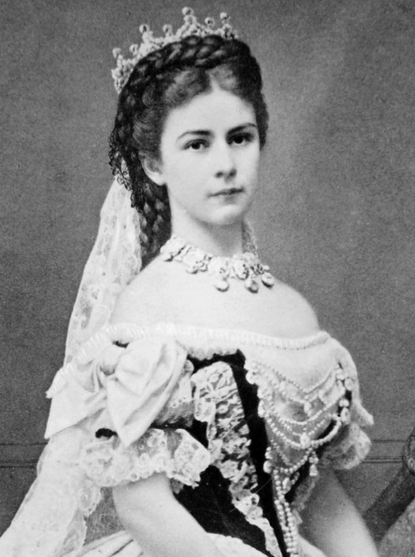
Empress Elizabeth of Austria
“Ah, the horror of growing old, to feel the hand of Time laid upon one’s body, to watch the skin wrinkling, to awake and fear the morning light, and to know that one is no longer desirable! Life without beauty would be worthless to me.”

Slide 5
Inspiration’s counsel
Eleven times Paul refers to "things."
The quest for "things" robs many of true joy.
The key concept is "count."
Stop and look at the commanding motive for obtaining the “thing.”

Slide 6
You must DECIDE to be Joyful! (Philippians 3:1-11)
What is most valuable to you?
What consumes your priorities of time and energy?
What are you doing with the limited time God has given you on earth?

Slide 7
Decide what things give the appearance of joy (verses 1-6)
Associations (verse 2)
Confidence in the "flesh" (verse 3)
Racial and regional heritage (verse 5)
Mechanical religion (v. 5)
Education (verse 5)
Morality (verse 6)
Zeal (verse 6)

Slide 8
Decide what will result in true joy (verses 7-11)
The superiority of Christ Jesus (verse 8)
True righteousness (verse 9)
Fellowship with Christ (verses 10-11)

Slide 9
You must RUN the race with joy! (Philippians 3:12-16)
Toward the RIGHT GOAL (verse 12, 14)
With three REALIZATIONS (verses 12, 13)
Making THREE DECISIONS (verse 13)

Slide 10
Three CRITICAL Decisions
Decide about PRIORITIES (verse 13)
Decide to FORGET (verse 13)
Decide to STRETCH FORWARD (verse 13)

Slide 11
The right way (Philippians 3:12-16)
The RIGHT GOAL (verse 12, 14)
Three REALIZATIONS (verses 12, 13)
Making THREE DECISIONS (verse 13)
Proper ATTITUDES (verses 14-16)

Slide 12
Attitudes Bringing Joy
A resolve (verse 14)
A determined effort (verse 15)
A desire to obey and change (verse 15)
A steadfastness in living (verse 16)

Slide 13
The WRONG way (Philippians 3:17-19)
Belly a god (verse 19; Romans 16:18)
Glories in their shame (v. 19)
Earthly attitudes and goals (v. 19)

Slide 14
The TRAGIC RESULTS of the wrong way
Sorrow (verse 18)
Becomes an enemy of the cross (verse 18)
Faces destruction (verse 19)
Must be "marked" (verse 18)

Slide 15
The PLEA (Philippians 4:1)
Do not allow yourself to be swept away by the world's things.
The right way is found only "in the Lord."

Slide 16
Concluding Thoughts…
A great thief of joy in your life is love of the things of THIS world!
1 John 2:15-17; Luke 10:40; Mark 4:17-19

Slide 17
“WHO is master in your life?”
Do you possess your possessions OR do they possess you?
Mark 8:33, 36-37; 3 John 2

Slide 18
Luke 18 and 19 A Shocking Contrast!
The Rich Young Ruler (Luke 18:18-25)
Zaccheus (Luke 19:1-9)

Slide 19
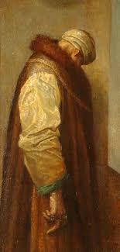
"I am doing a man's back—little else but his back—to explain, 'He went away sorrowful; for he had great possessions.' Fancy a man turning his back on Christ rather than give away his goods. They say his back looks sorry. It is what I meant to express."

Slide 20
Next Lesson…
The Christian has a Joyous Victory over WORRY! (Philippians 4)

